Slide 1

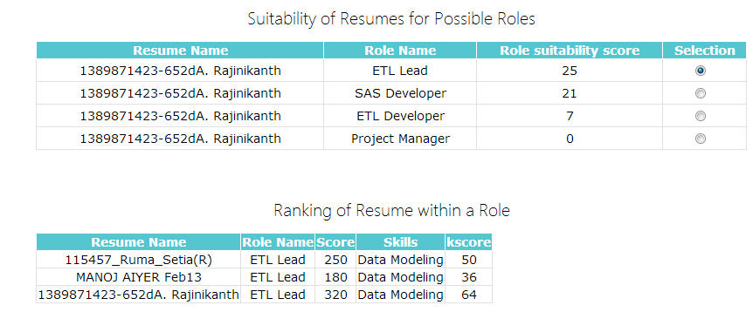


Resume Analyzer
Interviewer Profile
Ranking of profiles
Create Role
Clustering
Candidate Profile

